Slide 1
THEY BELONG IN TWO WORLDS
LEARNING ABOUT GYPSY AND TRAVELLER CULTURE AT KEY STAGE 3

Slide 2
About this resource
This resource is based on DEED’s Rites of Passage project funded by the Heritage Fund. It explores culture and memory with people from Dorset’s Gypsy, Roma and Traveller communities.
During the project, we interviewed a range of people, asking them about significant events in their life, often referred to as rites of passage, which we all can experience.
We produced the Rites of Passage booklet for everyone with this powerpoint for schools, which focuses on the lives of young Gypsies & Travellers as they leave school and move into adult life, often leaving two worlds behind.

Slide 3
Meet Violet
What questions might you want to ask her about her life?

Slide 4
About Violet
She is 16 years old.
She is a Traveller.
She is about to finish secondary school.
She lives in a house.
She has lots of friends and family that live near her.

Slide 5
Meet Shane
With family
Family days. We go to the cinema and stuff. Football… We get horses and we’re allowed to drive them around on our own. We drive cars round… I learnt when I was 6. My dad did the pedals and I steered, then when I grew up, he slowly taught me how to do it.
At school
They don’t really like Travellers. None of them. You walk past people, and they go ‘…Gypsies’. You get into fights, and you get told off.

Slide 6
Meet Demi
In my culture girls aren’t allowed to go out alone. I’ll go with my sister and brother to the shop. My mum’s worried about other people. We won’t have a boyfriend yet. On TV when it shows them having boyfriends young, that’s not us. My mum says, ‘When you’re old enough and you’ve got a proper job, think about it then.’

Slide 7
Questions for you!
Why might school be challenging time for Violet, Shane or Demi?
Thinking about Violet, Shane & Demi
What do think each of them might feel about leaving school and their life ahead?
Young Gypsies and Travellers often live in two worlds. One within their community living a settled life very close to their family and friends; and one with friends and adults at school. School is often a difficult time in a teenage Gypsy or Traveller’s life. Can you think why?
Do you have anything in common with Violet, Shane or Demi?
How can we make school a safer space for those who may feel vulnerable or isolated?

Slide 8
Thinking about freedom and rules: Young Gypsies and Traveller often experience very different freedom and rules at home from school. They learn much from home as well as from school.
Jenny, in her 60s, talks more about Romany Gypsy culture
Amy, in her 30s, talks more about the Traveller lifestyle
My children are half Traveller, half Gorja. I’m bringing them up in the Traveller lifestyle. I’d rather live my life as it is now, than I would as a non-Traveller. The life I was brought up in, and the life I’m giving my children, is the best life they could ever have.
Romany people are very close, and loyal. You know if you have a problem you can pick up the phone and someone will be down straight away. They are also spotlessly clean and old fashioned. The boys are taught to be respectful to girls, and are smart and polite, and younger people have respect for their elders. They are creative and can make something out of nothing.

Slide 9
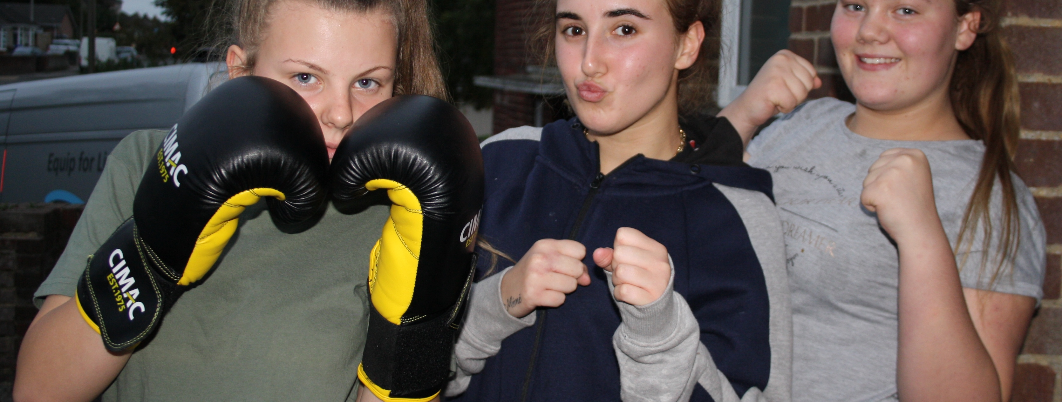
Why do you think Amy chooses to bring her children up in the Traveller lifestyle, with all its challenges, and she has a choice?
Discuss

Slide 10
Extended question:
How far do all young people, including Gypsies and Travellers, live in two worlds, one influenced by family , heritage and culture, the other influenced by friends and school ?

Slide 11
Further resources available to explore Gypsy, Roma & Traveller issues
Rites of Passage: Culture & Memory in Dorset’s Gypsy, Roma & Traveller communities
Friends, Families & Travellers
A national charity that works on behalf of all Gypsies, Travellers and Roma.
https://www.gypsy-traveller.org/
Available to download
https://deed.org.uk/deed-dorset-hampshire-dorset-gypsy-traveller-stories
Kushti Bok
Ghost Gypsy
Local Gypsy & Traveller led organisation promoting equality and raising awareness in Dorset
https://www.kushtibokdorset.co.uk/
A short community film looking at the life of Violet, a young Traveller looking for her ‘true self’ with the help of the ghost of her great grandmother.
https://www.youtube.com/watch?v=yWGHuquIJrU&t=5s

